Slide 1
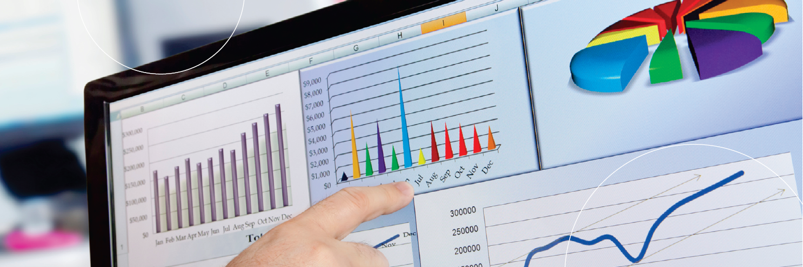
5
Business Analytics

Slide 2
Learning Objectives
Understand Managers Job and Decision Making
Learn to use decision support framework to demonstrate how IT supports managerial decision making.
Describe business analytics (BA) process.
Describe BA tools and examples.
Understand the definition and use cases for descriptive, predictive, and prescriptive analytics.

Slide 3



IS such as Business Analytics (BA) can help to provide the right information to the right person, in the right amount, at the right time, in the right format.
Business is all about decision making: Yes, No, or Maybe???
What happened?
Why is this happening?
What will happen if the trend continues?
What will happen next?
What is the best (or worst) that can happen?
Where the problem is?
What actions should we take to achieve successful business outcomes?
https://www.youtube.com/watch?v=SXZoqd40KVc

Slide 4

Management and Decision Making
Management: A process by which an organization achieves its goals through the use of resources (people, money, materials, and information).
Productivity: The ratio between the inputs and outputs to measure managers’ success.
Decision: A systematic process of making choice among two or more alternatives.

Slide 5



Basic Roles of Managers
Interpersonal Roles: Figurehead, leader, liaison.
Informational Roles: Monitor, disseminator, spokesperson, analyzer.
Decisional Roles: Entrepreneur, disturbance handler, resource allocator, negotiator.
https://www.lynda.com/Leadership-Management-tutorials/three-strikes-rule/126132/711522-4.html

Slide 6
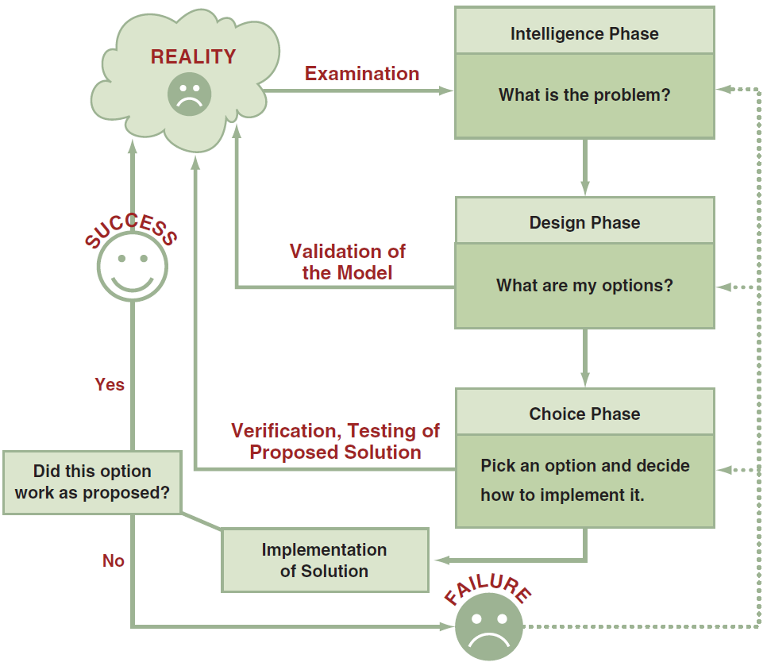
Process and Phases of Decision Making
Intelligence Phase: Examine a situation; identify and define the problem or opportunity.
Design Phase: Addressing the situation; Validate decision model; evaluate potential solutions.
Choice Phase: Select a solution or course of action to resolve the problem.
Implementation Phase: Implement solutions to solves the problem or seizes the opportunity.

Slide 7

Managers Need IT Support to Make Right Informed Decisions
The number of alternatives
Decisions made under time constraints: Business agility
Uncertainty for sophisticated analyses
Computer-based decision support

Slide 8
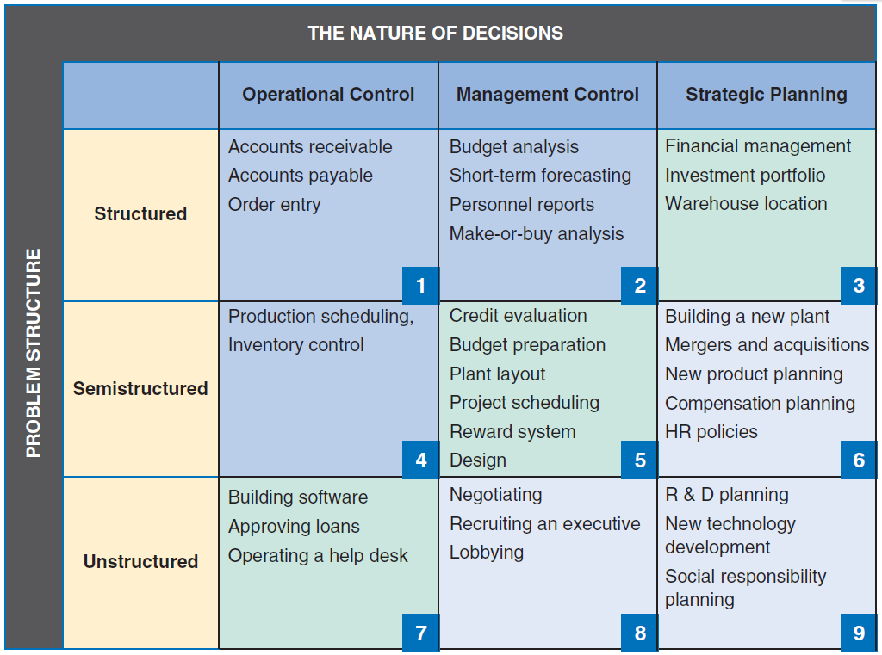
Decision Support Framework & Decision Matrix
    Problem Structure:
    Structured
    Unstructured
    Nature of Decisions
    Operational
    Management
    Strategic

Slide 9
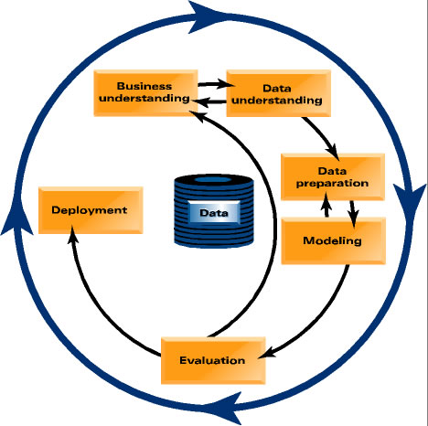
Business Analytics (BA):
Process of developing actionable decisions or recommendations for actions.
Based on insights from historical data.
A variety of tools and techniques.
Develops descriptive, predictive, and prescriptive models.
Communicates results to decision makers.
https://study.com/academy/lesson/what-is-business-analysis-process-methods-example.html

Slide 10
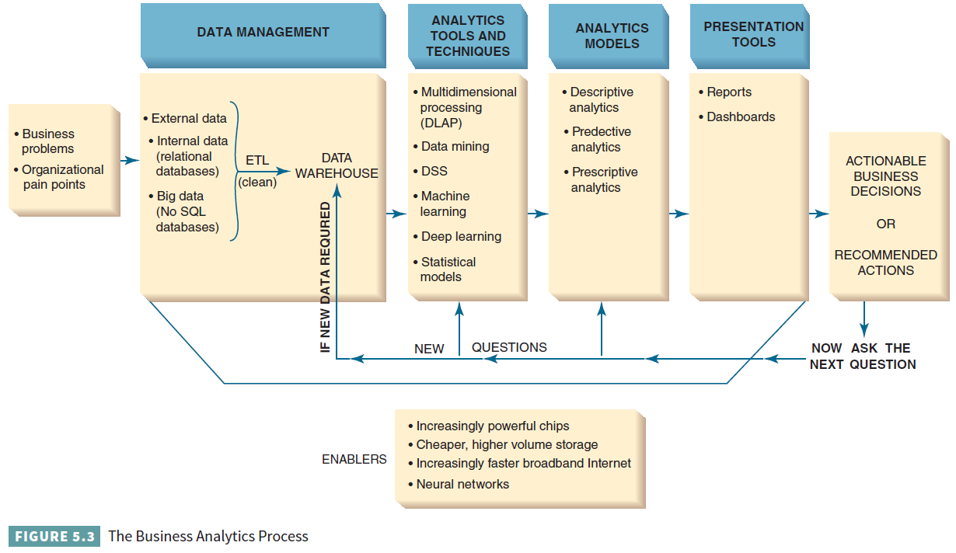
Business Analytics Process

Slide 11
3 Mini Cases on Business Analytics
Wal-Mart: Hurricane Frances.
MegaTelCo: Predicting Customer Churn.
Target: Predicting Pregnancy.
https://hbr.org/video/2386816175001/business-analytics-defined

Slide 12
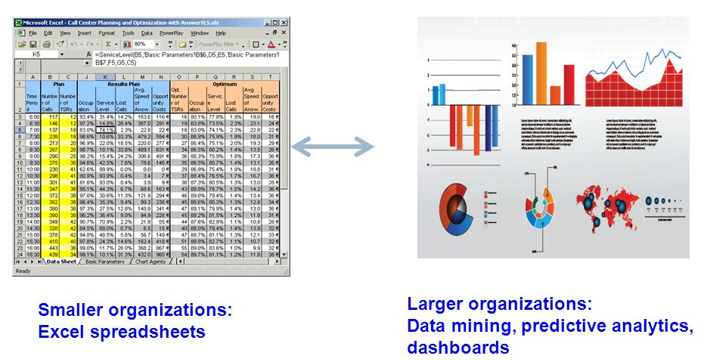
Scope of Business Analytics
Development of One or a Few Related Analytics Applications
The Development of Infrastructure to Support Enterprise wide Analytics
Support for Organizational Transformation
Depending on business focus, scope, resources, technical architecture, and benefits: Ongoing

Slide 13
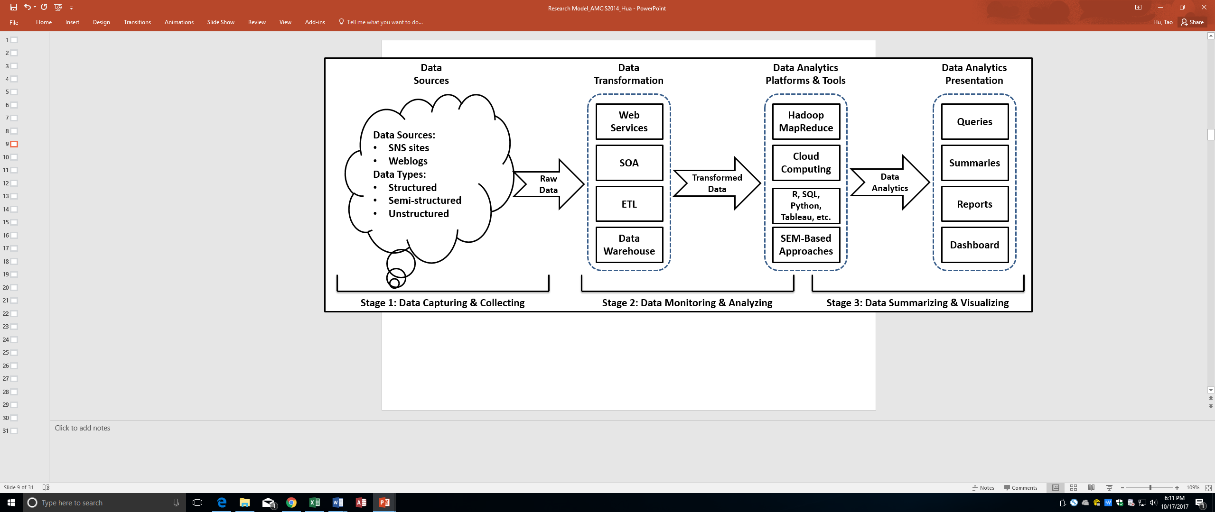
Business Analytics Tools
Excel: The most popular BA tool by far.
Online Analytical Processing (OLAP)
Real-Time Business Analytics: The use of real time data for analysis rather than historical data.
The 18 Best Analytics Tools Every Business Manager Should Know: https://www.forbes.com/sites/bernardmarr/2016/02/04/the-18-best-analytics-tools-every-business-manager-should-know/#9c0cf005d397
And, many more…

Slide 14
Major Business Analytics Technique
Data Mining:
Process of searching for valuable business information in a large database, data warehouse, or data mart.
2 basic operations: (1) predicting trends and behaviors and (2) identifying previously unknown patterns.
Helps to explain why it is happening, and it predicts what will happen in the future.

Slide 15
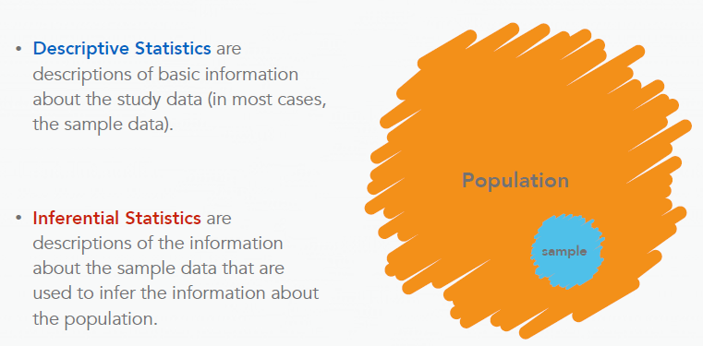
Business Analytics Models
Descriptive Analytics:
Summarize what has happened in the past and allow decision makers to learn from past behaviors.
Common examples: Reports of an organization’s production, operations, sales, finance, inventory, and customers.

Slide 16
Business Analytics Models
Descriptive Analytics: One more example
Table A1 Demographics of respondents (N = 518)
Category | Value | Frequency | Percentage
Gender | Female | 275 | 53.1%
 | Male | 243 | 46.9%
Ethnicity | White | 323 | 62.4%
 | African-American | 116 | 22.4%
 | Asian | 53 | 10.2%
 | Hispanic | 9 | 1.7%
 | Native American | 1 | 0.2%
 | Other | 16 | 3.1%
Work Status | Not Work Full Time | 297 | 57.1%
 | Work Full Time | 222 | 42.9%
Age Range | 17 -20 | 117 | 22.6%
 | 21 -25 | 212 | 40.9%
 | 26 – 30 | 99 | 19.1%
 | 31 – 35 | 44 | 8.5%
 | 36-40 | 27 | 5.2%
 | 41-45 | 9 | 1.7%
 | Above 45 | 10 | 1.9%
Site Used Most | Facebook | 405 | 78.2%
 | MySpace | 56 | 10.8%
 | LinkedIn | 17 | 3.3%
 | Orkut | 14 | 2.7%
 | Twitter | 7 | 1.4%
 | Classmate | 4 | 0.8%
 | Yahoo 360 | 3 | 0.6%
 | Hi5 | 1 | 0.2%
 | Friendster | 1 | 0.2%
 | Other | 10 | 1.9%

Slide 17
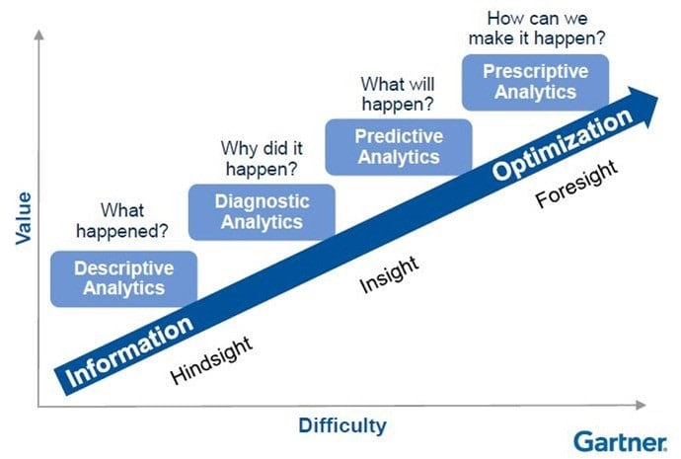
Business Analytics Models:
Predictive Analytics:
  To examine historical data to detect patterns and predict future outcomes and trends.
Prescriptive Analytics:
  Recommending courses of action and showing the likely outcome of each decision.
  Predict multiple future outcomes based on the decision maker’s actions.

Slide 18
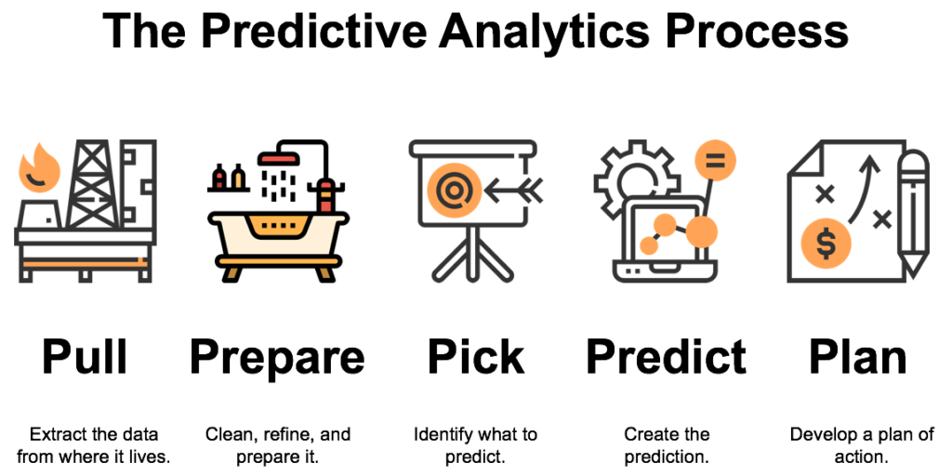
Predictive Analytics: More Examples
Website predict which ads you will click on
Leading online dating companies match compatible individuals
Financial Service Firms produce credit scores
Predict sales based on which products are purchased together

Slide 19

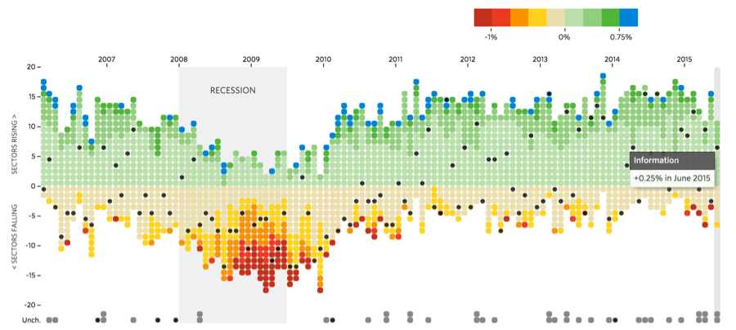
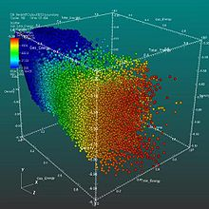
Business Analytics Presentation Tools
Data Visualization:
Data presented in visual formats such as text, graphics, and tables.
Makes analytics results more attractive and understandable.

Slide 20
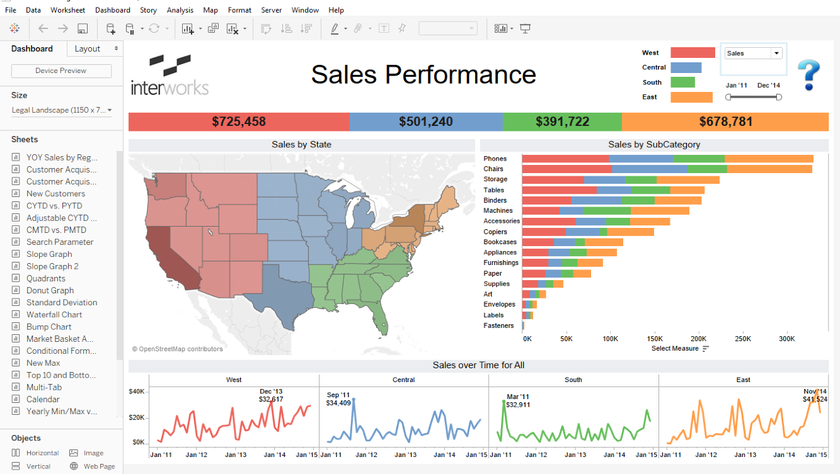
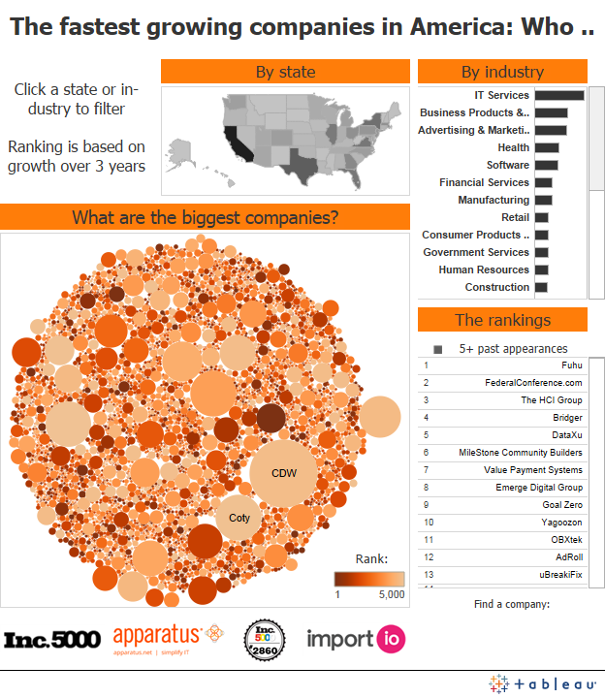
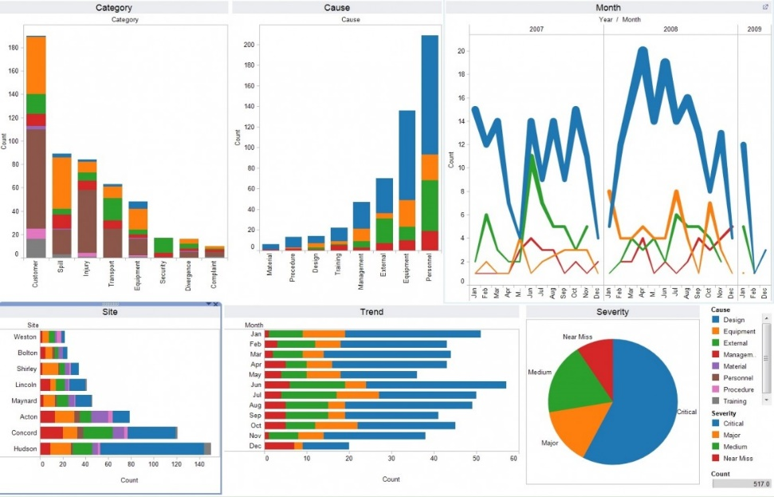
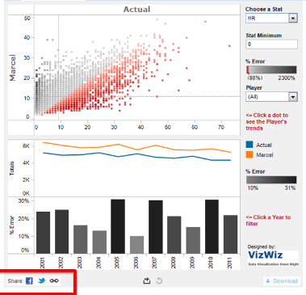
Business Analytics Presentation Tools
Dashboard:
Provides easy access to timely information
Direct access to management reports.

Slide 21
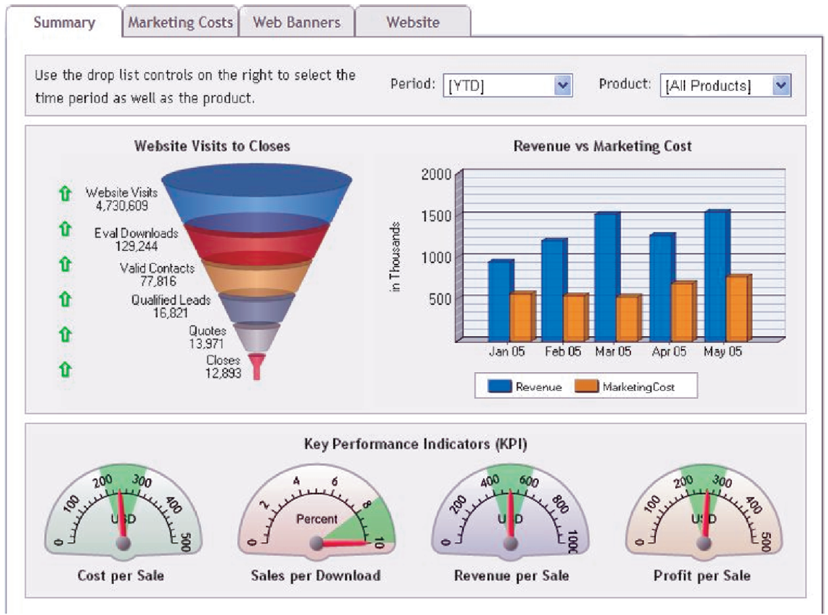
A Performance Dashboard

Slide 22
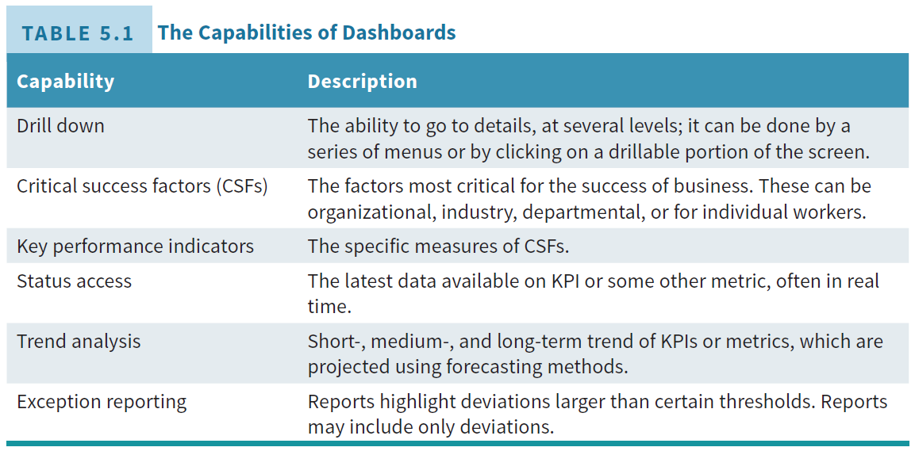
Capabilities of Dashboards

Slide 23
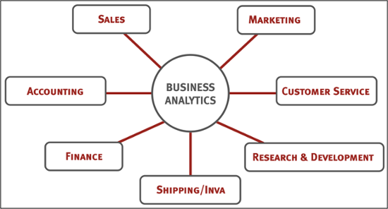
Business Analytics Application Areas
Retailing & Sales
Banking
Manufacturing & Production
Insurance
Healthcare
Marketing
Weather
Higher Education
……

Slide 24
Summary
Understand Managers Job and Decision Making
Learn to use decision support framework to demonstrate how IT supports managerial decision making.
Describe business analytics (BA) process.
Describe BA tools and examples.
Understand the definition and use cases for descriptive, predictive, and prescriptive analytics.

